Slide 1

Akuntansi Keuangan
MATERI :
PERSAMAAN DASAR AKUNTANSI
TINJAUAN ATAS SIKLUS AKUNTANSI
LAPORAN LABA RUGI
LAPORAN POSISI KEUANGAN DAN CATATAN ATAS LAPORAN KEUANGAN
Dosen : Maryati Rahayu, SE, MM

Slide 2
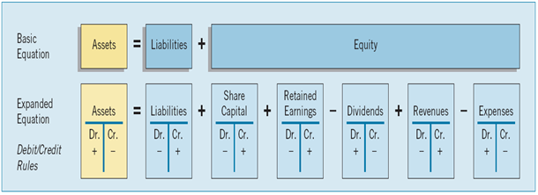
Persamaan Dasar Akuntansi

Slide 3
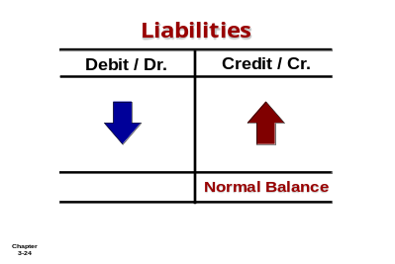
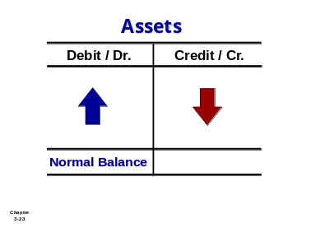
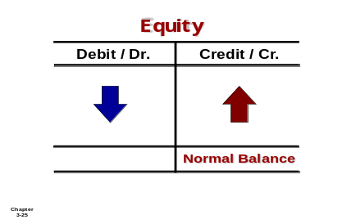
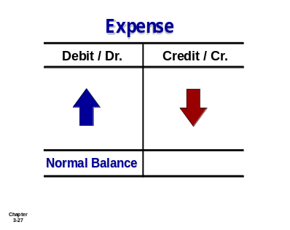
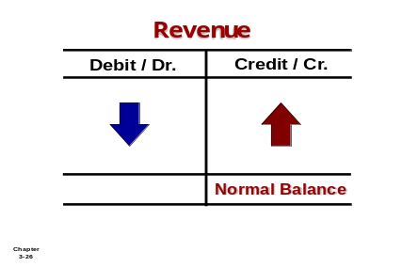

Debits and Credits Summary
Normal Balance Debit
Normal Balance Credit

Slide 4
The Accounting Cycle (Siklus Akuntansi)
Identifying and recording
Journalizing
Posting
Trial balance
Adjusting entries
Adjusted trial balance
Preparing financial statements
Closing
Post-closing trial balance
Reversing entries
Summary

Slide 5
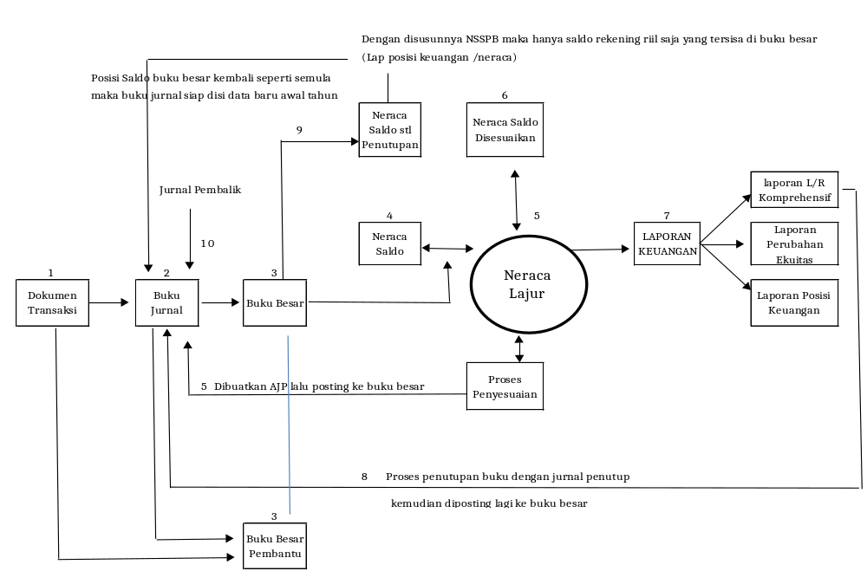
Gambar Siklus Akuntansi

Slide 6
Laporan Laba-Rugi (Statement of Comprehensive Income Statement)
Income includes both revenues and gains.
  Revenues - ordinary activities of a company
  Gains - may or may not arise from ordinary activities.
Revenue Accounts
Gain Accounts
  Sales
  Fee revenue
  Interest revenue
  Dividend revenue
  Rent revenue
  Gains on the sale of long-term assets
  Unrealized gains on available-for-sale securities.

Slide 7
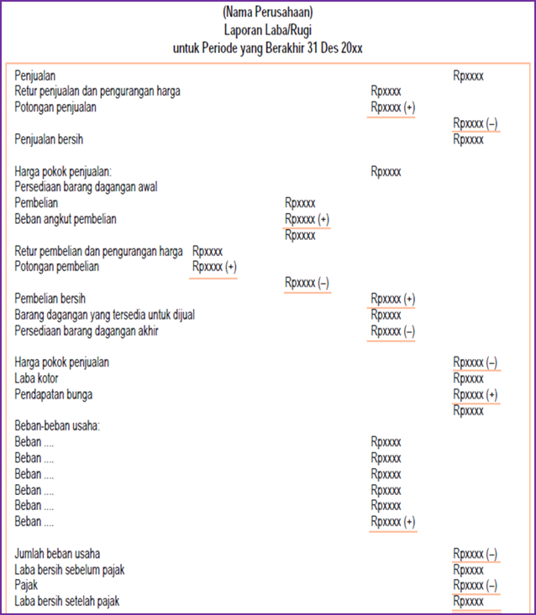
Contoh penyajian Lap L/R (Multiple Step)

Slide 8
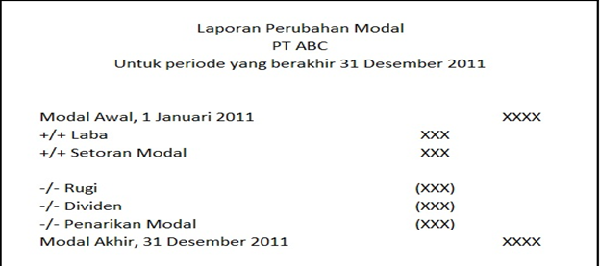
Laporan Perubahan Ekuitas

Slide 9
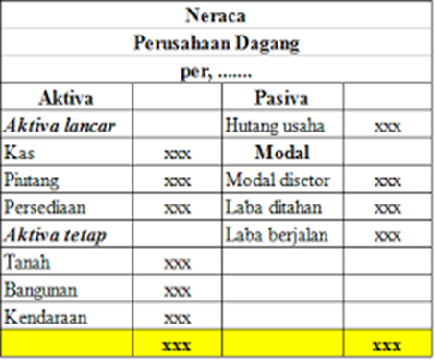
Laporan Posisi Keuangan

Slide 10
Selamat Belajar
Tugas: Kerjakan Soal Latihan di Word

